Slide 1




Green Transition
English F-E - GF2
What is green transition and why is it important?
Materialet er udviklet af
faglærer Nina Gaul, EUC Syd, 2026

Slide 2

What is Green Transition?
Green transition means making society more environmentally friendly.
It focuses on reducing pollution and using renewable energy.

Slide 3
Why is it Important?
Climate change is a global problem.
We need to reduce CO2 emissions.
Protect nature and future generations.

Slide 4
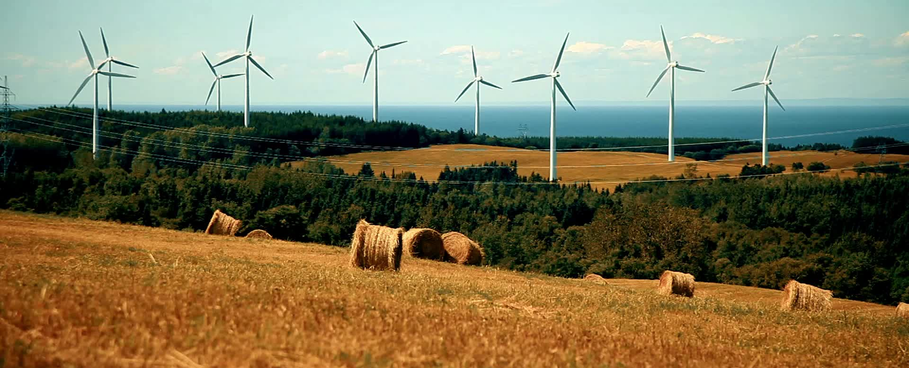
Renewable Energy
Examples:
- Wind energy
- Solar energy
- Water energy
These are better than fossil fuels.

Slide 5
Green IT
IT systems use a lot of energy.
Data centers consume electricity.
AI can help reduce energy use.

Slide 6
Examples in Everyday Life
Recycling
Using public transport
Saving electricity
Using green energy

Slide 7
Discussion
Why is green transition important?
What can you do to help the environment?

Slide 8
Conclusion
Green transition is necessary.
Technology and people must work together.
Small actions can make a big difference.

