Slide 1

Green Transition
English E - GF2
What is green transition and why is it important?
Materialet er udviklet af
Faglærer Nina Gaul, EUC Syd, 2026

Slide 2

Green transition

Slide 3

What is Green Transition?
Green transition means making society more environmentally friendly.
It focuses on reducing pollution and using renewable energy.

Slide 4

Why is it Important?
Climate change is a global problem.
We need to reduce CO2 emissions.
Protect nature and future generations.

Slide 5
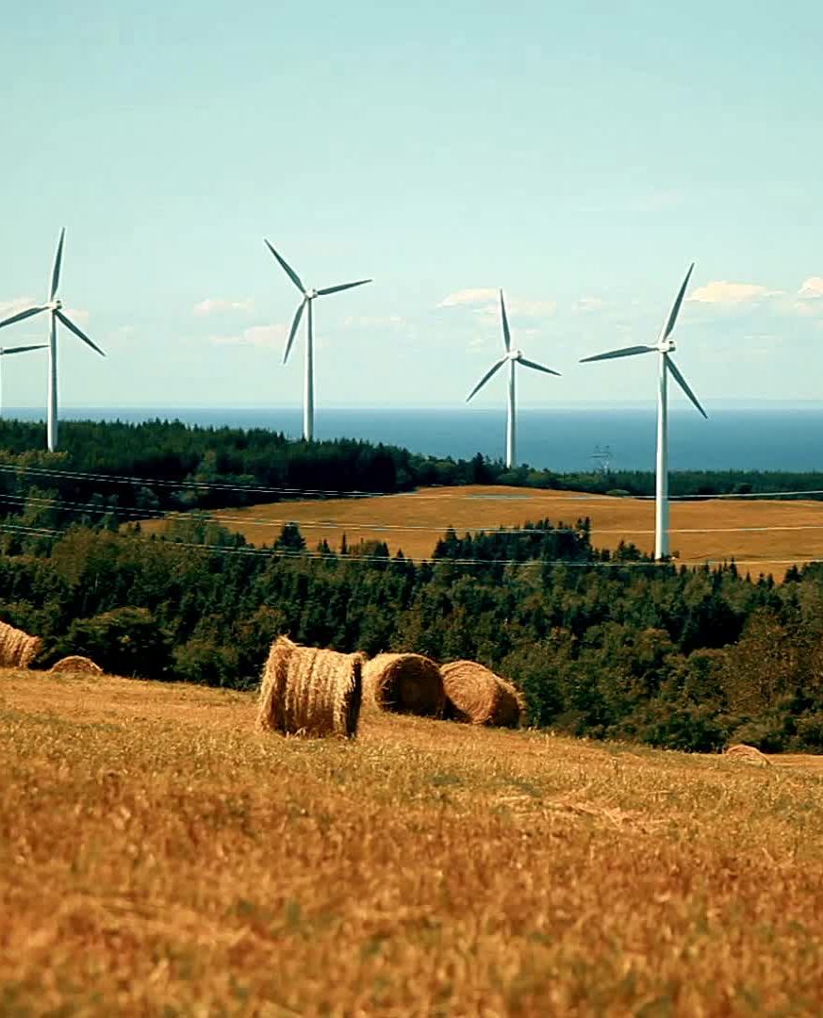
Renewable Energy
Examples:
- Wind energy
- Solar energy
- Water energy
These are better than fossil fuels.

Slide 6
Green IT
IT systems use a lot of energy.
Data centers consume electricity.
AI can help reduce energy use.

Slide 7
Examples in Everyday Life
Recycling
Using public transport
Saving electricity
Using green energy

Slide 8
Discussion
Why is green transition important?
What can you do to help the environment?

Slide 9
Conclusion
Green transition is necessary.
Technology and people must work together.
Small actions can make a big difference.

Slide 10
What happens with your disposal electronics?
https://www.youtube.com/watch?v=4GtWGHvX-rk

